Slide 1

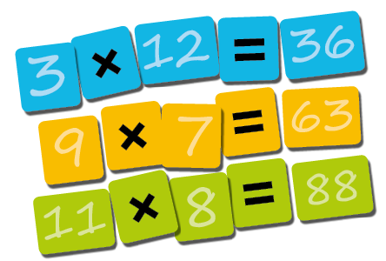

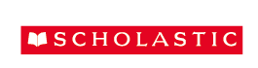
Digital file 13: 11-times table: Football crazy
Notes:
^{STEPS}
Display digital file 13 (11-times table: Football crazy). This requires some explanation:
Each year 12 football teams, who have all scored more goals than they have conceded, are put into 2 lists: 1 for the first half of the season and the other for the second half of the season.
For every goal a team has scored more than they have conceded, the difference is multiplied by the number of games they have played (in each case 11). They are then awarded points for that half of the season. (Spend time on the concept and calculation of goal difference; it is the key to the activity.)
So, a team that has played 11 games, scored 5 goals and conceded 3, would score
11 × (5 − 3); which is 11 × 2 = 22 points.
When the points for each half of the season are added together, the team with the most points is the winner.
Children should work on completing resource 6 (Football crazy), independently, in pairs or in groups as desired. Once the aim is clear, the process is quite straightforward. Children will succeed if they approach the work methodically.
The aim is to work out who will get the most points when the points for the 2 halves of the season are added together, and who will get the fewest. (Answer: Team G will get the most with 231 points; and team F will get the fewest with ^{33 points.)}
^{EXTEND}
Ask the children to write out the complete list of teams in order of points, from highest to lowest, and to write how many more points each team scored than the 1 below it. From this, they should write how much better their goal difference was, for example team G won with 231 points, and team L were second with 220 points. There is an 11 point difference, which means that team G had a 1-goal better difference than L.

Slide 2
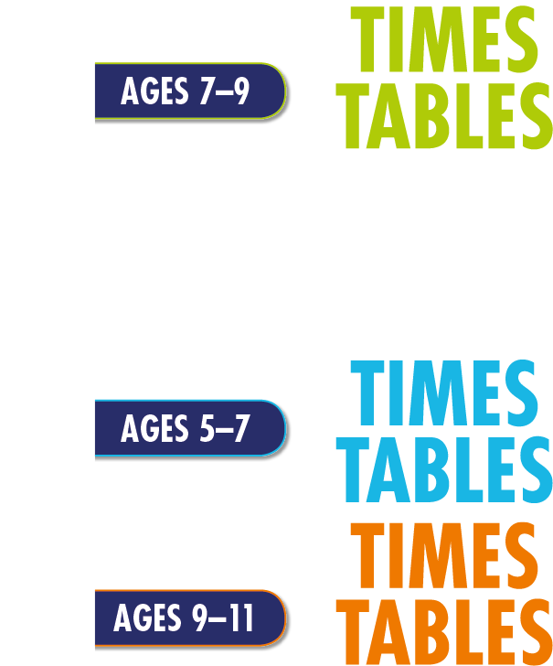
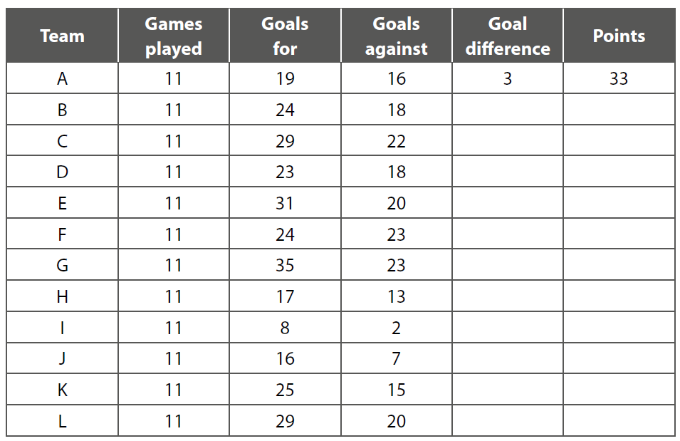

First half of the season

Slide 3
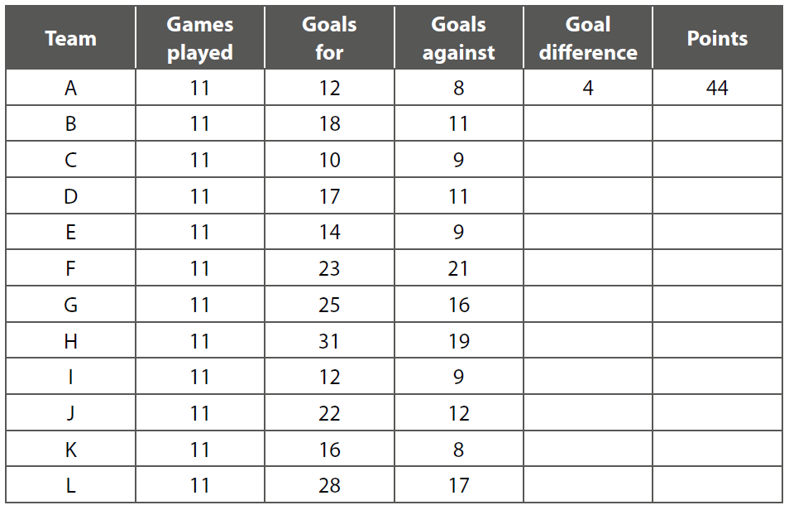
Second half of the season

